Slide 1


Design and Analysis of a Supermarket Database
This presentation presents our semester project for the EU4 of BUT Informatique at the IUT of Saint-Dié-des-Vosges. The main objective was to create a database for a supermarket, using various tools and developing our skills in data handling and statistics.
We chose this topic for its interest and feasibility, involving a variety of entities and numerical data essential to modeling and analysis. This project improved our skills in database design, SQL programming and statistical analysis, preparing us for effective data management.
par Skython
Antoine Barthélémy, Lucas Cesar
IUT of Saint-Dié-Des-Vosges

Slide 2
Analysis and identification of entities
This crucial step is to identify the entities, attributes and associations needed for our supermarket database. We conducted extensive research to understand the typical structures of supermarket databases, justifying our choices and quoting our sources.
It is important to note that this database is designed for the complete internal system of the supermarket, not for a customer application. This is why entities such as "Employee" are included. An entity is a numerical representation of a real-world object, described by attributes.
Key entities
Secondary entities
Customer
Promotion
Product
ProductRating
Bill
Stock
Supplier
PurchaseOrder
Employee
BillLine
Department
BasketLine
Sale
PromotionProduct
Basket
SaleLine

Slide 3

Supermarket Data Analysis: Key Insights
This presentation delves into key attributes of supermarket data, including average basket size, critical stock levels, and the tension between sales and stock. We will explore the methodologies, calculations, and interpretations of these analyses, providing valuable insights for strategic business decisions.

Slide 4

Analysis: Average Basket Size
1
Indicator Selection
2
Calculations
We selected average and standard deviation to analyze basket amounts. The average is preferred over the median due to the absence of outliers, while standard deviation measures purchase homogeneity.
The average basket amount is €28.02, calculated using a weighted sum of basket values. The variance is 231.64€², leading to a standard deviation of €15.22.
3
Interpretation
The average of €28.02, slightly inflated by some expensive baskets, and a high standard deviation of €15.22, indicate significant variability in customer spending.

Slide 5



Average Basket: Detailed Calculations
Average Calculation
Variance Calculation
Standard Deviation
The average basket value is €28.02. This is derived from the formula: (0.02 × 7) + (0.04 × 9) + (0.06 × 10) … + (0.02 × 64).
The variance, an intermediate step for standard deviation, measures the dispersion of squared values. It is calculated as 0.02 × (7 − 28.02)² + 0.04 × (9 − 28.02)² + … + 0.02 × (64 − 28.02)² = 231.64€².
The standard deviation, which measures value dispersion without power, is the square root of the variance: √231.64 = €15.22.

Slide 6
Average Basket: Visualization and Interpretation
The histogram below illustrates the distribution of basket amounts, showing a high concentration between €10-25, representing frequent customer purchases. The superimposed density curve reveals an asymmetrical distribution skewed right, indicating most customers spend less, while a few make higher-value purchases up to €60.
The calculated average of €28.02 and a standard deviation of €15.02 confirm significant variability. Most amounts fall between €13.00 and €43.04, highlighting considerable dispersion around the average.

Slide 7
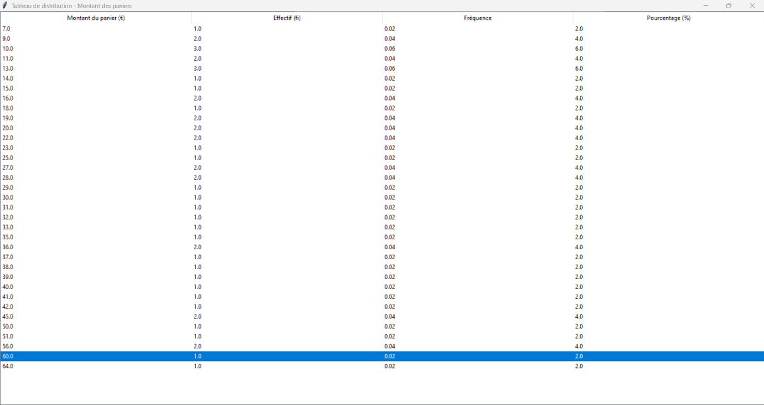

Slide 8
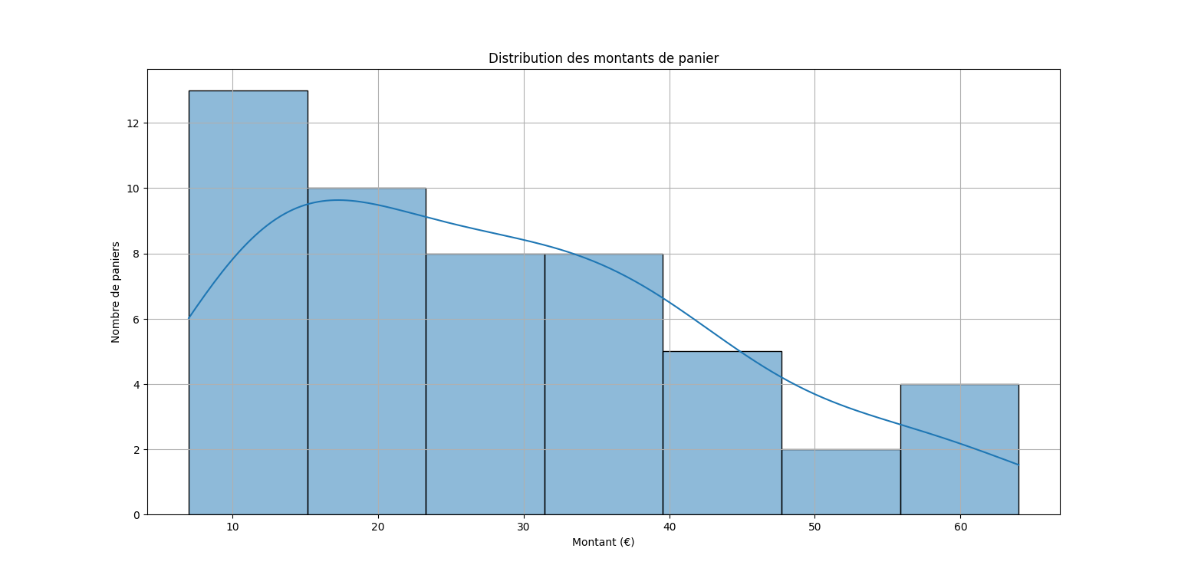

Slide 9
Analysis: Critical Stocks
Indicator Selection
Calculations
We use minimum stock, critical limit, and a decreasing ranking of products by available stock. The minimum identifies lowest stocks, the critical limit highlights urgent situations, and ranking prioritizes actions for decision-makers.
The minimum quantity available is 60 units. No statistical distribution is needed as values are discrete and few.
Interpretation
The analysis of available stock shows moderate concentration between 120 and 250 units, but also critical situations. Three products are below the critical threshold, signaling potential out-of-stock risks for decision-makers.

Slide 10
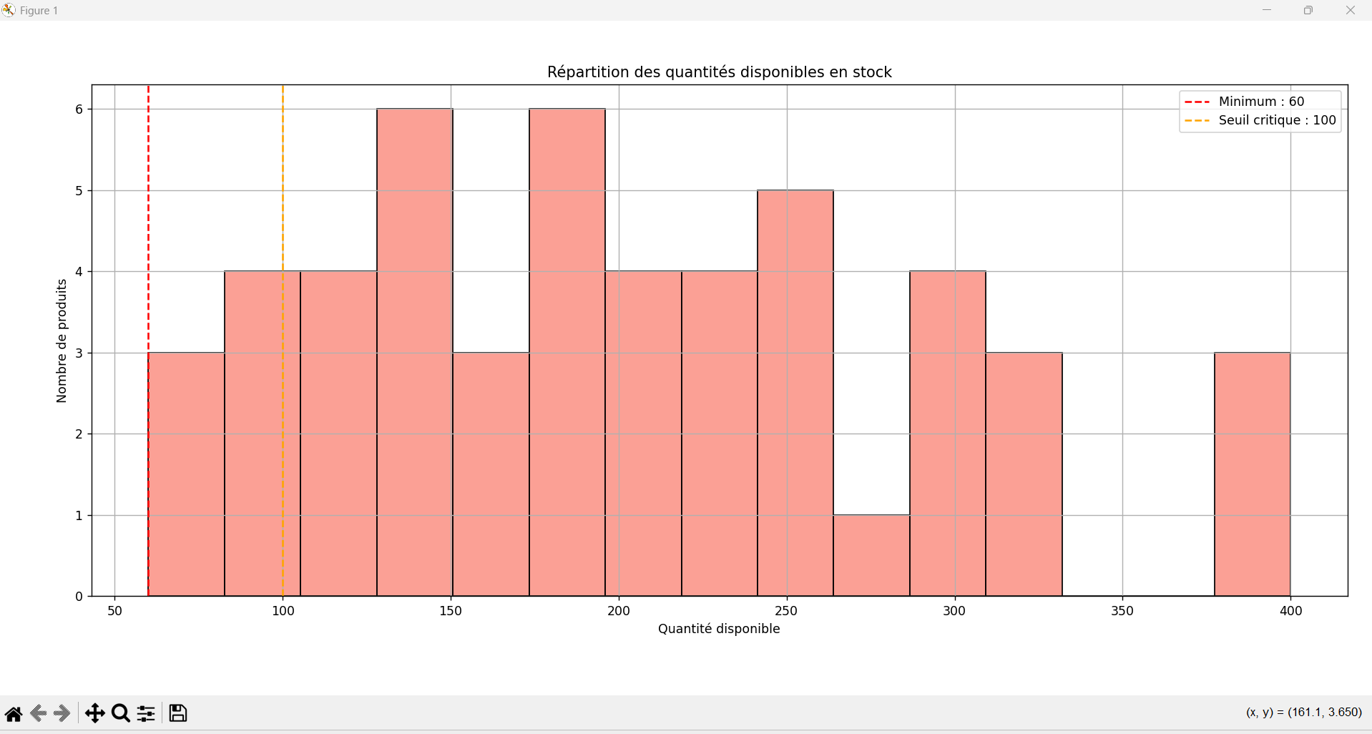

Slide 11

Critical Stocks: Visualization
The graph below displays the distribution of available quantities in stock, revealing the overall structure of supply levels. While there's a moderate concentration around certain values (particularly between 120 and 250 units), it also highlights products in more critical situations.
Notably, three products fall below the critical limit, serving as a warning signal for stock management. This visualization is crucial for decision-makers to anticipate potential out-of-stock risks and prioritize necessary actions.

Slide 12




Analysis: Tension Between Sales and Stock
Objective
Determine the correlation between product quantity sold and quantity available in stock using the Pearson linear correlation coefficient.
Pearson's Coefficient
This coefficient is used for two quantitative variables. It is not to be confused with the Pearson asymmetry coefficient.
Average Usage
The average is a key tool used to complete the Pearson correlation formula.

Slide 13

Tension Between Sales and Stock: Calculations
The average quantity purchased per product is 2.48 units, meaning consumers typically buy two items when a product is purchased. The average available quantity in stock is 295.16 products.
The Pearson correlation coefficient is calculated as -0.6799. This negative value indicates an inverse relationship: as sales increase, available stock tends to decrease. The code for these calculations is available in the Appendix.

Slide 14
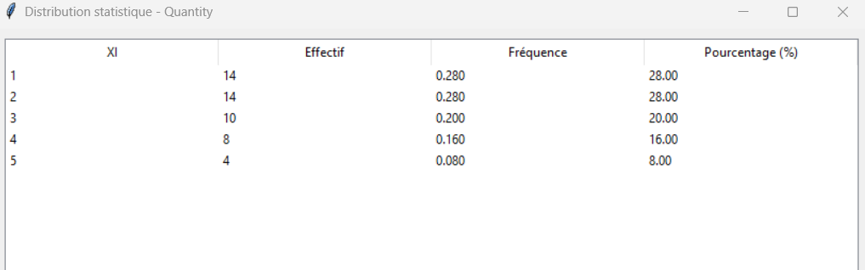
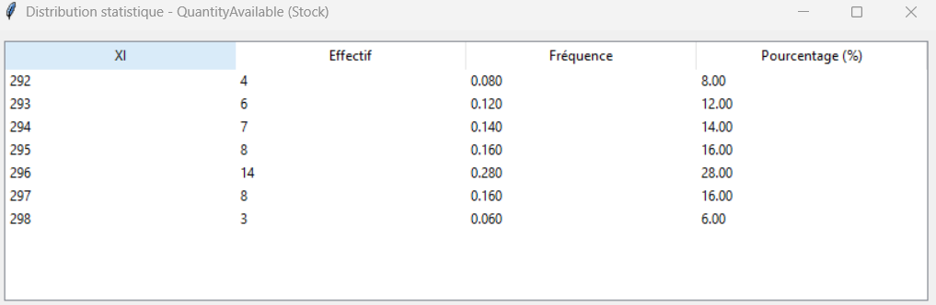
Tension Between Sales and Stock: Visualization
The statistical distributions below illustrate the relationship between sales and stock. The first chart shows the distribution on the billLine table, while the second shows the distribution on the stock table. These visualizations help confirm the inverse correlation.
The more a product is sold, the lower the available stock tends to be, as confirmed by the Pearson correlation coefficient of -0.6799. This highlights a significant tension between sales and stock, which could lead to stockouts if supply is not adequately adjusted.

Slide 15
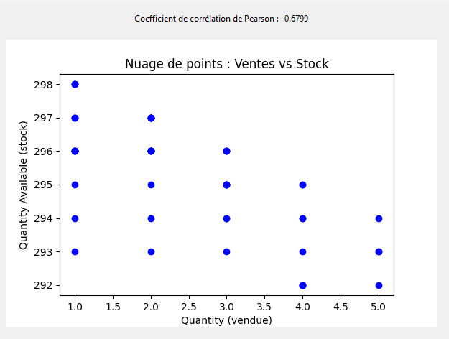

Slide 16

Conclusion: Key Takeaways
Database Mastery
This project reinforced our SQL skills, including relational database design, DML triggers, and data integrity.
Meaningful Insights
We extracted valuable insights on customer behavior, inventory, and sales performance, emphasizing data's role in strategic decisions.
Analytical Proficiency
We enhanced our ability to produce valuable indicators using Python and data visualization tools, structuring complex datasets effectively.
Overall, this SAE provided practical experience in database modeling and advanced statistical analysis, crucial for real-world business challenges.

